Slide 1
Autogynephilic Addiction
Transition Radio Television (New Mexico) G Eugene Pichler
Tuesday, October 27, 2015

Slide 2
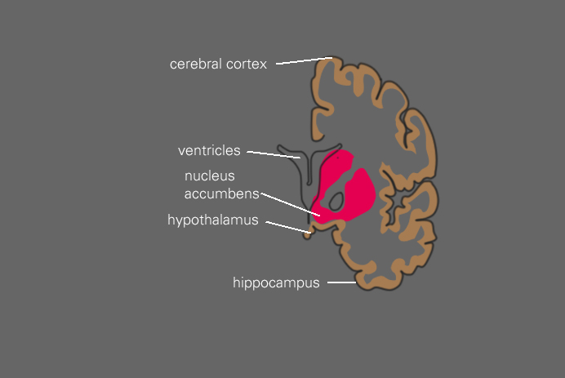
The Theory Behind Behavioral Addiction
We feel good when neurons in the reward pathway release a neurotransmitter, called dopamine, into the nucleus accumbens

Slide 3
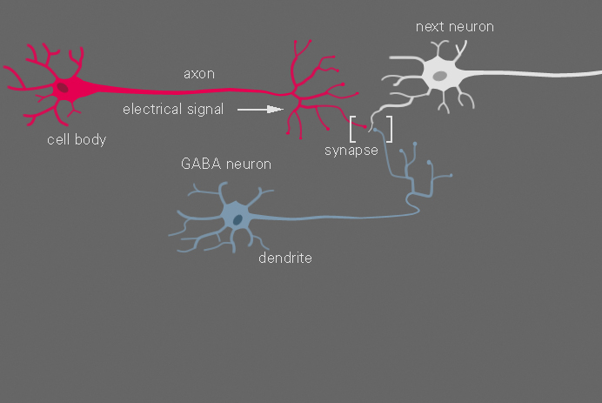
The Theory Behind Behavioral Addiction
Figure 2: Synapse

Slide 4
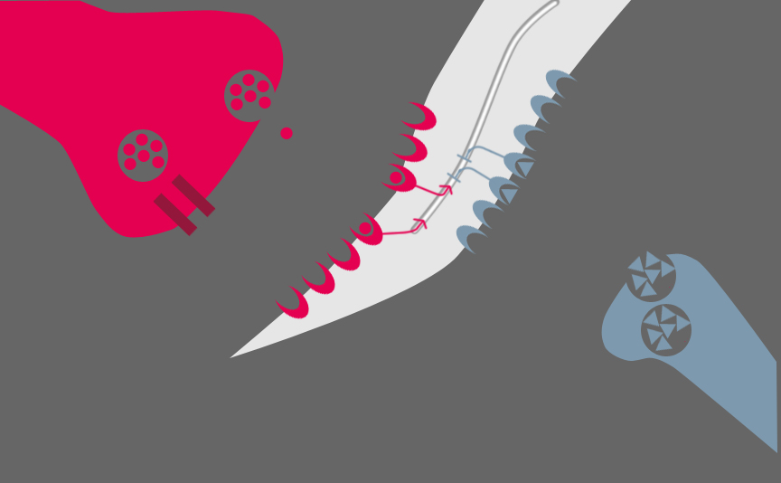
The Theory Behind Behavioral Addiction
figure 3: an example of a healthy reward system

Slide 5
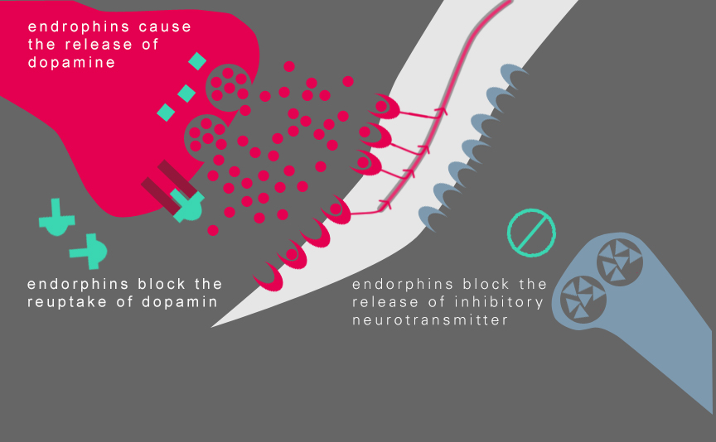
The Theory Behind Behavioral Addiction
figure 4: an example of a faulty reward system

Slide 6
Behavioral Addiction and Heredity
Behavioral Addiction is a mental disorder
The illness is contracted via heredity; the illness passes from the chromosomes of the male parent to the offspring.
The disorder is three time more prevalent in male offspring than female offspring. Thus, the male-to-female ratios of behavioral addiction is ~3:1.

Slide 7
Examples of non-substance-related addictions
Pathological gambling
Shopping
Sport
Working
Computer
Internet
Sex

Slide 8
Autogynephilic Addiction
Autogynephilia is a behavioral addiction.
Autogynephilic addiction works in the same manner as sex addiction, Internet addiction or gambling addiction, and is caused by a faulty reward system in the human brain.
Autogynephilia meets all the diagnostic characterists of a behavioral addiction

Slide 9
Characteristics of behavioural addictions (Grüsser and Thalemann, NIH)
Characteristics of behavioural addictions according to Grüsser and Thalemann [9] include:
The behaviour is exhibited over a long period of time (at least 12 months) in an excessive, aberrant form, deviating from the norm or extravagant (e.g., regarding its frequency and intensity)
Loss of control over the excessive behaviour (duration, frequency, intensity, risk) when the behaviour started
Reward effect (the excessive behaviour is instantly considered to be rewarding)
Development of tolerance (the behaviour is conducted longer, more often and more intensively in order to achieve the desired effect; in unvaried form, intensity and frequency the desired effect fails to appear)
The behaviour that was initially perceived as pleasant, positive and rewarding is increasingly considered to be unpleasant in the course of the addiction

Slide 10
Characteristics of behavioural addictions (Grüsser and Thalemann, NIH) (Cont.)
Irresistible urge/craving to execute the behaviour
Function (the behaviour is primarily employed as a way to regulate emotions/mood)
Expectancy of effect (expectancy of pleasant/positive effects by carrying out the excessive behaviour)
Limited pattern of behaviour (also applies to build-up and follow-up activities)
Cognitive occupation with the build-up, execution and follow-up activities of the excessive behaviour and possibly the anticipated effects of the excessively executed behaviour

Slide 11
Characteristics of behavioural addictions (Grüsser and Thalemann, NIH) (Cont.)
Irrational, contorted perception of different aspects of the excessive behaviour
Withdrawal symptoms (psychological and physical)
Continued execution of the excessive behaviour despite negative consequences (health-related, occupational, social)
Conditioned/learned reactions (resulting from the confrontation with internal and external stimuli associated with the excessive behaviour as well as from cognitive occupation with the excessive behaviour)
Suffering (desire to alleviate perceived suffering)

Slide 12
Life cycle of Autogynephilic Addiction
Autogynephilic addiction in males has a predictable lifecycle, including five distinct phases.
Phase 1, Contraction (begins as the person sexually develops, either at age 5 or at age 11 or thereabouts.)
Phase 2, Affirmation (begins as the person seizes on the consideration of a gender transition, involving a GRS procedure, etc.)

Slide 13
Life cycle of Autogynephilic Addiction (cont.)
Phase 3, Escalation (sets in during the period leading up to major invasive feminizing procedure, affecting the testosterone level, like a GRS procedure. By phase 3 the disorder firmly takes on the diagnostic characterists of a behavioral addiction.)
Phase 4, Rapid Cycling (sets in after the person has fully recovered from a major invasive feminizing procedure, affecting the testosterone level, where the testes are protracted)
Phase 5, Exhaustion (sets in after the person undergoes a number of feminizing procedures, following a major invasive feminizing procedure, like a GRS procedure or orchiectomy, where the testes are protracted and the individual no longer exhibits a sex drive.)

Slide 14
Objective Tests for Autogynephilic Addiction
Sexual Identity versus Gender Identity
Arousal-based Sexual Identity occurs at the age of 5 years old and is mutable.
Gender Identity occurs at the age of 12 to 18 months and is immutable.
Objective Tests
Only one question is necessary to determine autogynephilic addiction in males and conversely autoandrophilic addiction in females. Has anyone who knew you as a toddler at 18 months or thereabouts reported that you tugged on your clothing in an apparent attempt to remove gender appropriate clothing?

Slide 15
Male-to-female ratios of behavioral addictions
Jan Wålinder of Göteborg, observed the male-to-female ratio of pathological transsexualism as 2.8 to 1.
Eklund et al report the male-to-female ratio of transsexualisty as 3 to 1.
The male-to-female ratio of pathological sex addiction is 3 to 1.
the male-to-female ratio of pathological gambling addiction is 2.8 to 1

Slide 16
Case Study: Michael, a.k.a., Mickey, (Dr. Elise Shore)
Background
Subject signed up at a gender identity program at age 22.
Subject had undergone HRT for 21 months, and had been living exclusively in the female gender role for 14 months;
Subject presented as a “passable female”
Subject reverted to living as a male at age 24 after living in the female role for two-and-a-half years.
Subject’s onset of cross-gender proclivities began at age 8, when the subject began to cross-dress and expressed a wish to be like the other girls.
Subject’s proclivities towards cross-dressing waned in Junior High School
Subject was athletically active in High School.
Subject elevated to being the captain of his High School Football team as well as class president.

Slide 17
Case Study: Michael, a.k.a., Mickey, (Dr. Elise Shore) (cont)
Background (cont)
The subject reported he first identified as being a transsexual after watching a television program on the subject. The subject reportedly masturbated for the first time after watching the program.
The subject’s masturbation thoughts revolved around turning into a woman.
The subject’s sexual history involved only two incidents, one with a woman, the other with a man. In each case the other party is said to have made advances towards the subject.
After High School the subject went onto College
Subject reported suffering from depression in his final year of College and that the depressive episode lasted two years.

Slide 18
Case Study: Michael, a.k.a., Mickey, (Dr. Elise Shore) (cont)
Background
The subject reportedly did not take anything to treat the depression.
After graduating from College the subject immediately applied for a GRS procedure.
The gender identity clinic thought the subject was a good candidate to go through the gender transition and authorized him to undergo HRT.
The gender identity clinic followed the Harry Benjamin Foundation's Standards of Care.
the day before the subject was scheduled to undergo the GRS procedure, he was notified that the governing body of the hospital had decided to discontinue such procedures
The subject felt ‘relief’.
The subject became romantically involved met a woman he met at work.

Slide 19
Case Study: Michael, a.k.a., Mickey, (Dr. Elise Shore) (cont)
Analysis
As subject’s cross-gender proclivities did not begin until age 8, the diagnosis, Gender Identity Disorder, is fundamentally flawed.
The subject pursued otherwise masculine interests. The subject reported an indifferent sexual history. The subject’s sexual history fits the profile of asexual autogynephilia.
The subject reported suffering from depression but took nothing for it. In the absence of Selective Seratonin Reuptake Inhibitors (SSRIs), the body relies on its own natural mechanisms to bring itself back into balance.
50% of all people who suffer depression produce excess levels of cortisol.
Cortisol is a natural hormone

Slide 20
Case Study: Michael, a.k.a., Mickey, (Dr. Elise Shore) (cont)
Analysis
the hypothalamus kicks off the process by producing corticotrophic-releasing hormone (CRH), which in turn stimulates the adrenal glands, located near the kidneys, to produce the cortisol and release the chemical into the blood system.
The pituitary gland in turn produces adrenocorticotrophic hormone (ACTH).
ACTH has anticonvulsant effects on the human brain, forcing the nucleus accumbens of the brain back into balance.
By the time Michael's scheduled surgery date arrived, his interests in a gender transition had effectively evaporated.

Slide 21
Case Study: Michael, a.k.a., Mickey, (Dr. Elise Shore) (cont)
Fall out
On reading Shore's case study of the former transsexual, a number of the centralized gender identity clinics, including the Centre for Addiction and Mental Health (CAMH), began to dispense SSRIs as an alternative treatment to GRS procedures.
However, they were off the mark as SSRIs are largely ineffective at treating behavioral addictions, including the behavioral addiction, underlying transsexualism.

Slide 22
Case Study: #15, (Dr. Jan Wålinder) (cont)
Background
The subject was one of six siblings. One older sister; two older brothers and two younger brothers.
At age 12 the subject suffered a traumatic hit to the head.
At age 18 the subject fell while skiing and lost consciousness. No skull fracture was evident.
The subject was reportedly anxious as a child and easily upset
The subject got average marks in school.
After finishing High School and military service the subject worked in Forestry.
Subsequently, the subject worked as a truck driver.

Slide 23
Case Study: #15, (Dr. Jan Wålinder) (cont)
Background (cont.)
Up to the age of 23 the subject had a normal sexual development and he engaged in satisfying sexual relations with women.
At age 23 the subject felt he was being “transformed” into a woman and the subject began to periodically cross-dress.
At age 24 the subject married and with his wife had two children.
The subject’s proclivities towards transsexualism grew
As the subject’s interest in transsexualism grew the wife gradually lost interest in the subject.

Slide 24
Case Study: #15, (Dr. Jan Wålinder) (cont.)
Background (cont.)
At age 29 on the event that wife threatened to leave him, the subject sought treatment for his proclivities towards transsexualism.
Under examination the subject had an abnormal EEG, indicating Epilepsy.
As an experiment the staff administered Phenytoin—an anticonvulsant medication—to the subject. Three weeks later the subject’s proclivities towards a gender transition vanished.
The subject had an adverse reaction to the anticonvulsant medication and the medication had to be stopped.
On the event the medication was stopped the subject’s interest towards a gender transition re-emerged.
Other anticonvulsant were tried but were stopped when the subject complained of adverse side-effects.

Slide 25
Case Study: #15, (Dr. Jan Wålinder) (cont.)
Background (cont)
At age 30 the patient fully identified as a transsexual and was making plans to effect a gender transition.
The subject wife divorced him.
The subject reported that at age 31 his proclivities towards a gender transition had diminished for a time, but that the interest had fully re-emerged.
Subject reportedly felt he could no longer function as a man.

Slide 26
Case Study: #15, (Dr. Jan Wålinder) (cont.)
Analysis
As subject’s cross-gender proclivities did not begin until age 23, any diagnosis pointing towards Gender Identity Disorder would have been fundamentally flawed.
The subject pursued otherwise masculine interests. The subject reported satisfying relations with women. The subject’s sexual history suggests autogynephilia.
No addiction is reported in the father’s side of the family. People who are reportedly anxious, who seek excitement in life and who are more antisocial are far more likely to suffer from alcohol addiction than those that are not.
On the administration of anti-convulsant medication the subject’s proclivities towards a gender transition evaporated only to return when the medication was stopped.

Slide 27
Case Study: G (Pichler)
Background
The subject is an only child
The subject suffer trauma to the head from a fall as a toddler
The subject was somewhat shy and antisocial as a child
The subject’s father abused alcohol “all his life”
The subject began to question his sexuality at age five after an incident involving cross-gender role play
The subject cross-dressed as an adolescent, but stopped on the event he entered an undergraduate program at University.
The subject engaged in satisfying relations with a number of women until he met his first wife at age 26.

Slide 28
Case Study: G (Pichler)
Background
At age 34 the subject fathered a child, a daughter.
At age 36 the subject’s interests in cross-dressing re-emerge on the demise of a marriage to his first wife.
At age 36 the subject wife left him and fought to keep him from exercising any access to his daughter.
At age 37 the subject was diagnosed as having a Gender Identity Disorder by a certified psychiatrist as part of a family assessment for court.

Slide 29
Case Study: G (Pichler)
Background
At age 38 the subject underwent HRT for the purposes of effecting a gender transition.
At age 40 and after undergoing HRT for 24 months, the subject took anticonvulsant medication on complaints of being mildly depressed.
Within a few weeks the subject’s interest in a gender transition evaporated.

Slide 30
Case Study: G (Pichler)
Background
At age 41 the subject’s interests in a gender transition re-emerged
At age 41 the subject again underwent HRT for the purposes of effecting a gender transition
At age 41 the subject again took anticonvulsant medication for an ancilliary health issue.
At age 42 after a few months of taking anticonvulsant medication the subject’s interest towards a gender transition again evaporated.

Slide 31
Case Study: G (Pichler)
Background
At age 44 the subject again underwent HRT for the purposes of effecting a gender transition.
After only three months the patient complained of feeling depressed and stopped the medication.

Slide 32
Case Study: G (Pichler)
Analysis
The subject began to question his sexuality at age 5 after an incident involving gender role play. At age 5 a person’s gender identity is immutable. Any diagnosis of Gender Identity Disorder is thus fundamentally flawed.
The subject was reported introverted as a child, adding to the risk of succumbing to addiction.
The subject suffer trauma to the head as a child. Children that suffer trauma to the head as an infant and have brain legions are more likely to develop paraphilic tendancies later in life. [Kolársky et al. [1967] ]

Slide 33
Case Study: G (Pichler)
Analysis
The subject was never diagnosed with Epilepsy. However each time Dr. Cashman administered anticonvulsant medication to the subject, the subject proclivities towards a gender transition evaporated whether the subject suffered from a mild depression or not.

Slide 34
Illustrations of Autogynephilic Addiction, Phase 1, Contraction
The Outer Limits Original Series S1E11 - It Crawled Out of the Woodwork

Slide 35
Illustrations of Autogynephilic Addiction, Phase 1, Contraction (cont.)
The Outer Limits Original Series S1E30 – Production and Decay of Strange Particles

Slide 36
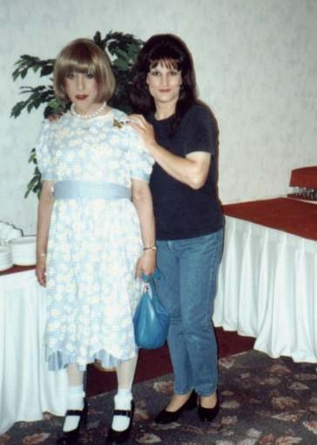
Illustrations of Autogynephilic Addiction, Phase 1, Contraction (cont.)
Proud mother who enjoys dressing her son as girl

